Slide 1
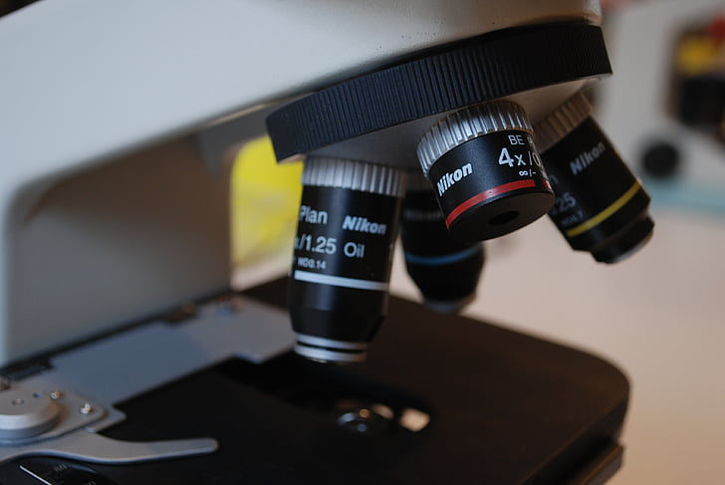
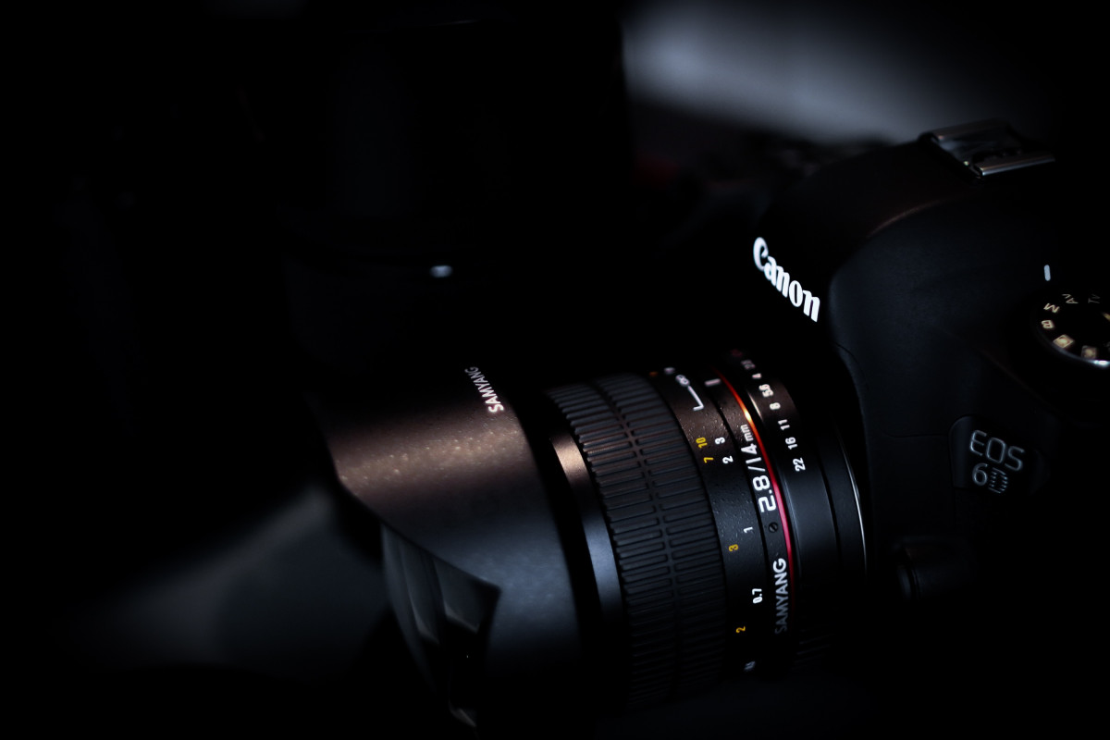
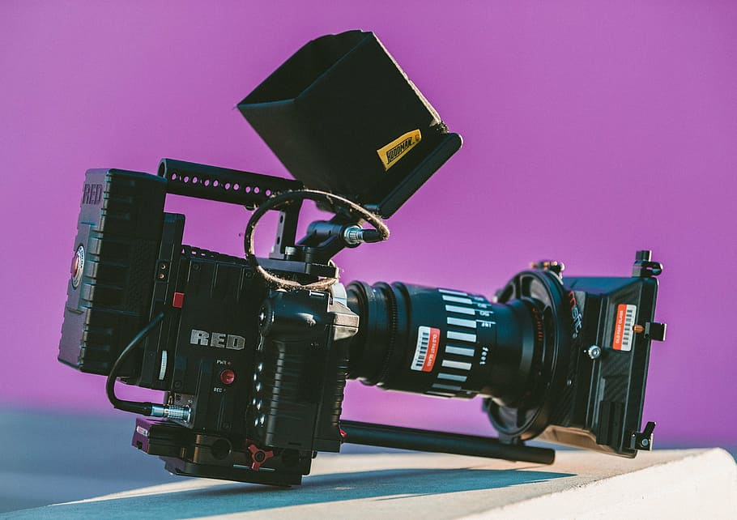
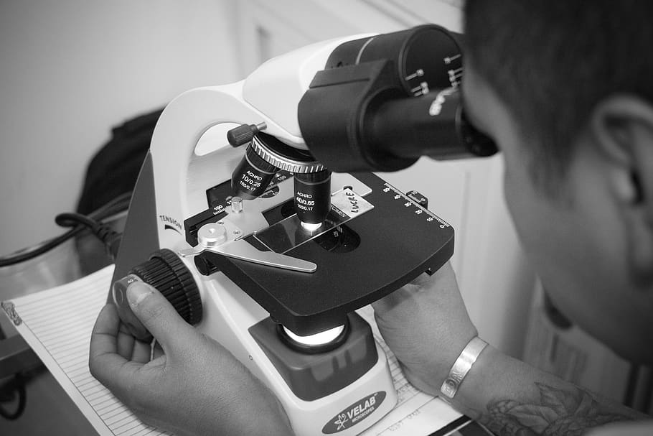
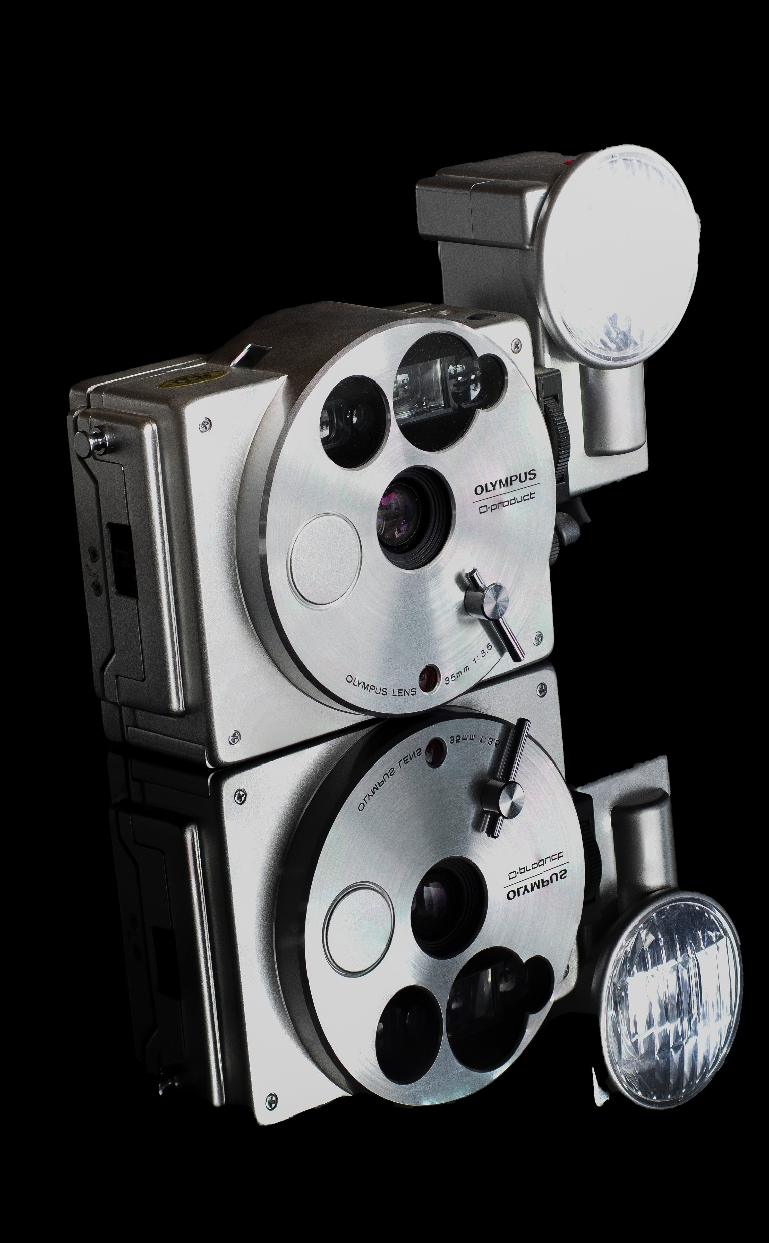
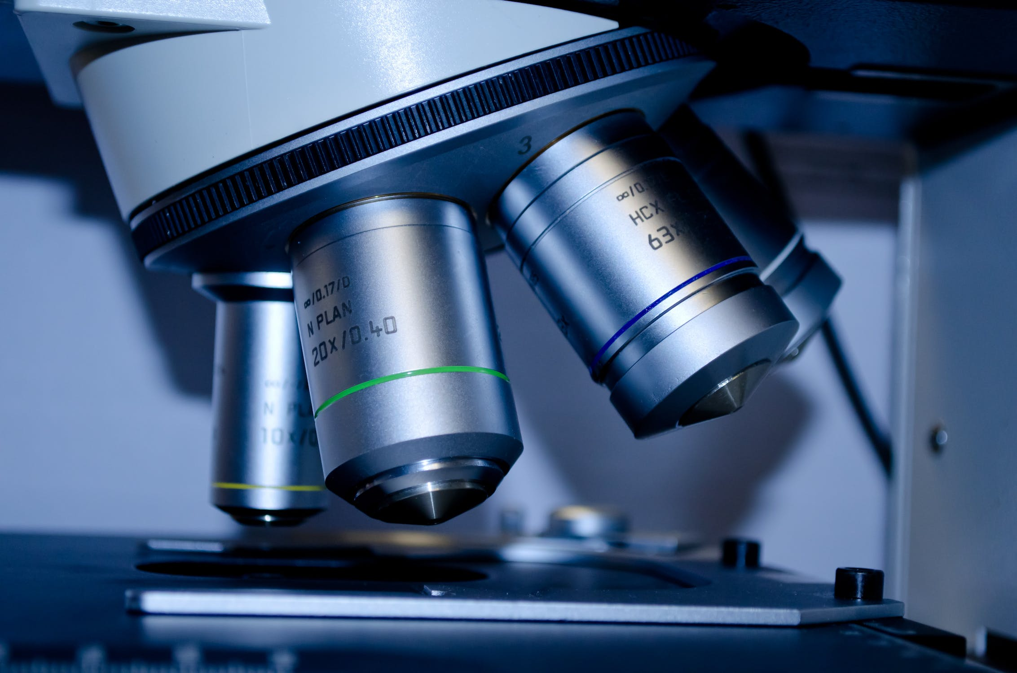
APP PHYSICS 167
APPLIED OPTICS
FUNDAMENTALS OF MICROSCOPY
BASIC MICROSCOPY
NINO PHILIP RAMONES | GITHUB
2020 – 05616
OCTOBER 23, 2023

Slide 2

APP PHYSICS 167
FUNDAMENTALS OF MICROSCOPY
OBJECTIVES
Observe interesting microscopic features of various materials under a stereomicroscope
Examine other microscopy methods that are much more advance and powerful in observing small scale details
KEY TAKEAWAYS
Achieving Köhler illumination in the specimen is crucial in observing the details of such object
Knowing how to properly calibrate the lens is important to obtain the possible clearest resolution of the lens
SOME PITFALLS
Encountered a problem in tuning the adjustment knobs and condensers due to lack of knowledge on how to properly calibrate the stereo lenses, which rendered an unilluminated and blurry image

Slide 3
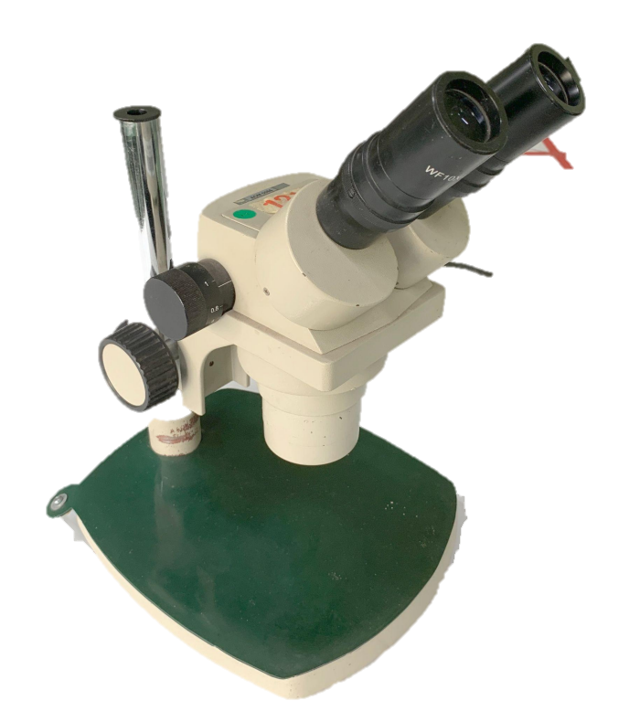
APP PHYSICS 167
FUNDAMENTALS OF MICROSCOPY
EXPERIMENTAL SETUP
In this activity, a stereomicroscope was used as the observing instrument for the small details of objects. It was called stereo as it has two objective lenses dedicated for each eyepiece.
The stereo objectives and binoculars allow depth perception, which are of use in examining miniscule 3D objects such as that of integrated circuits (Soriano, 2023).
Several objects were then examined such as paper bills, coins, threads of bracelets, and the RGB pixels of a smartphone screen.
Figure 1. Stereomicroscope used in the activity. Image sourced from the lecture slide provided by the instructor for AP 167 lecture class.

Slide 4
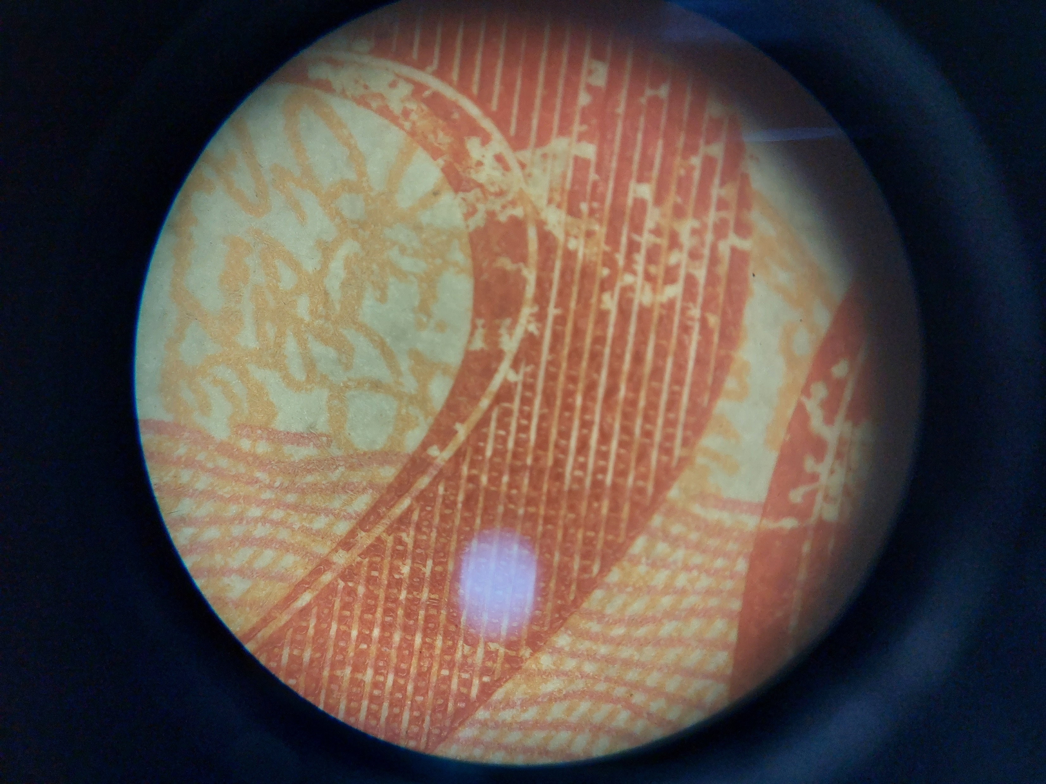
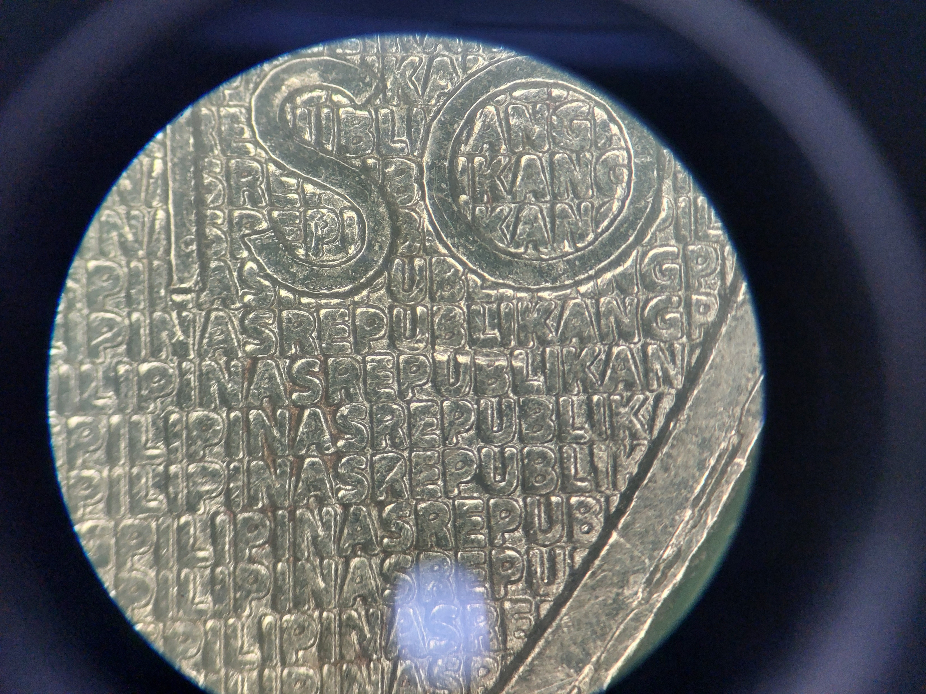
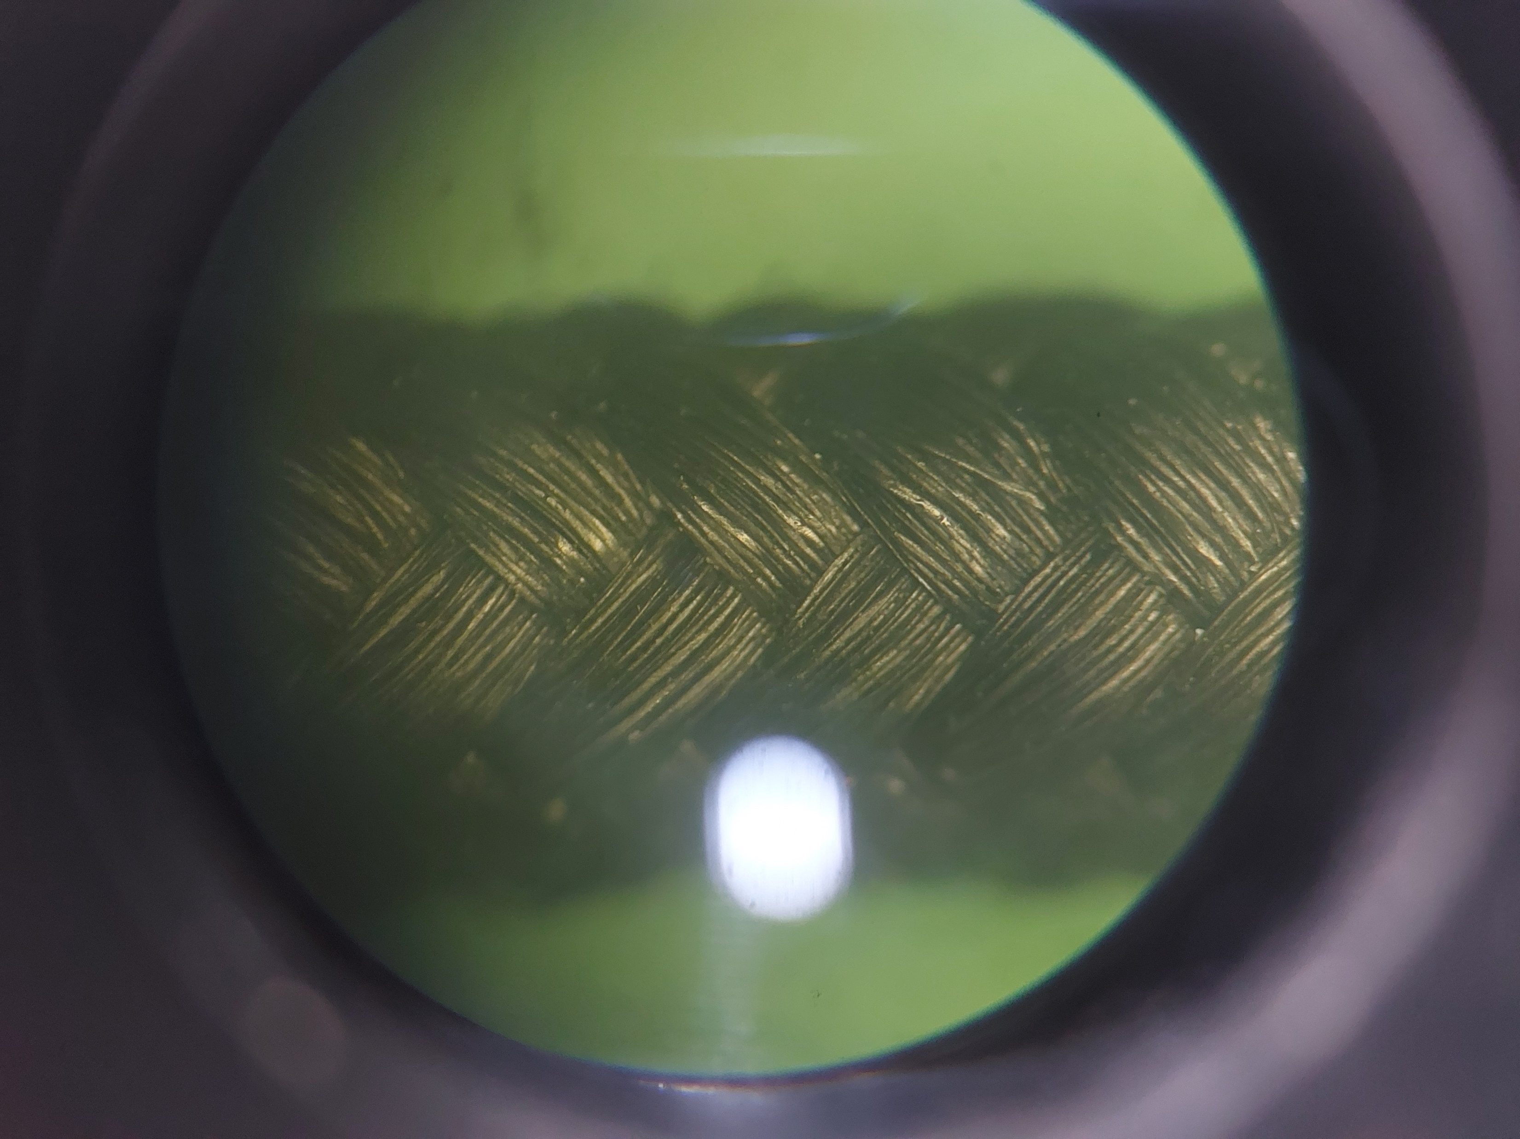
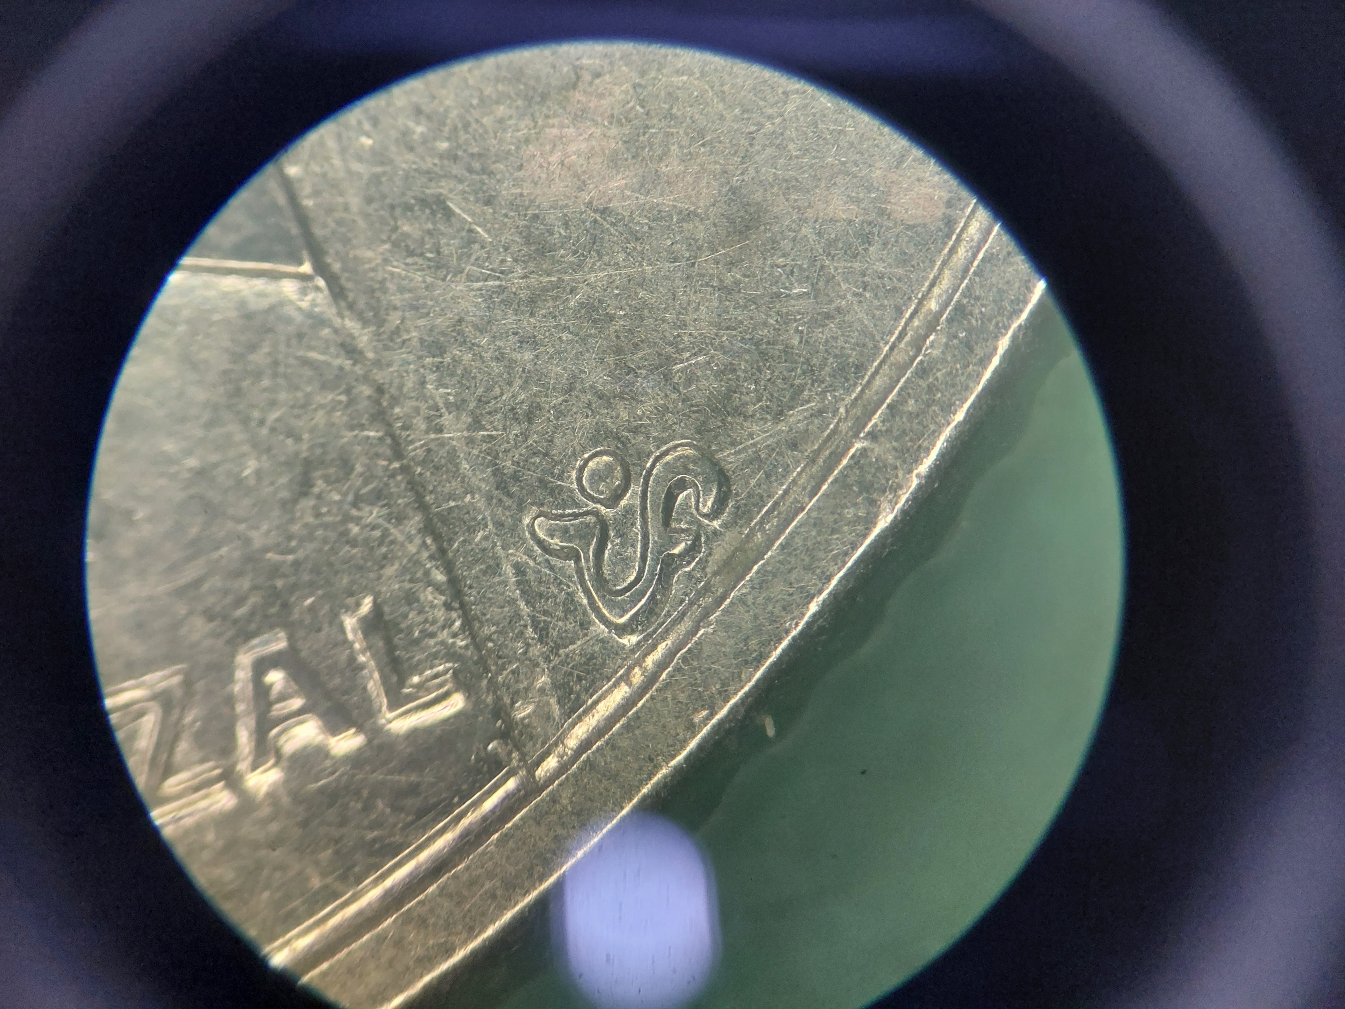
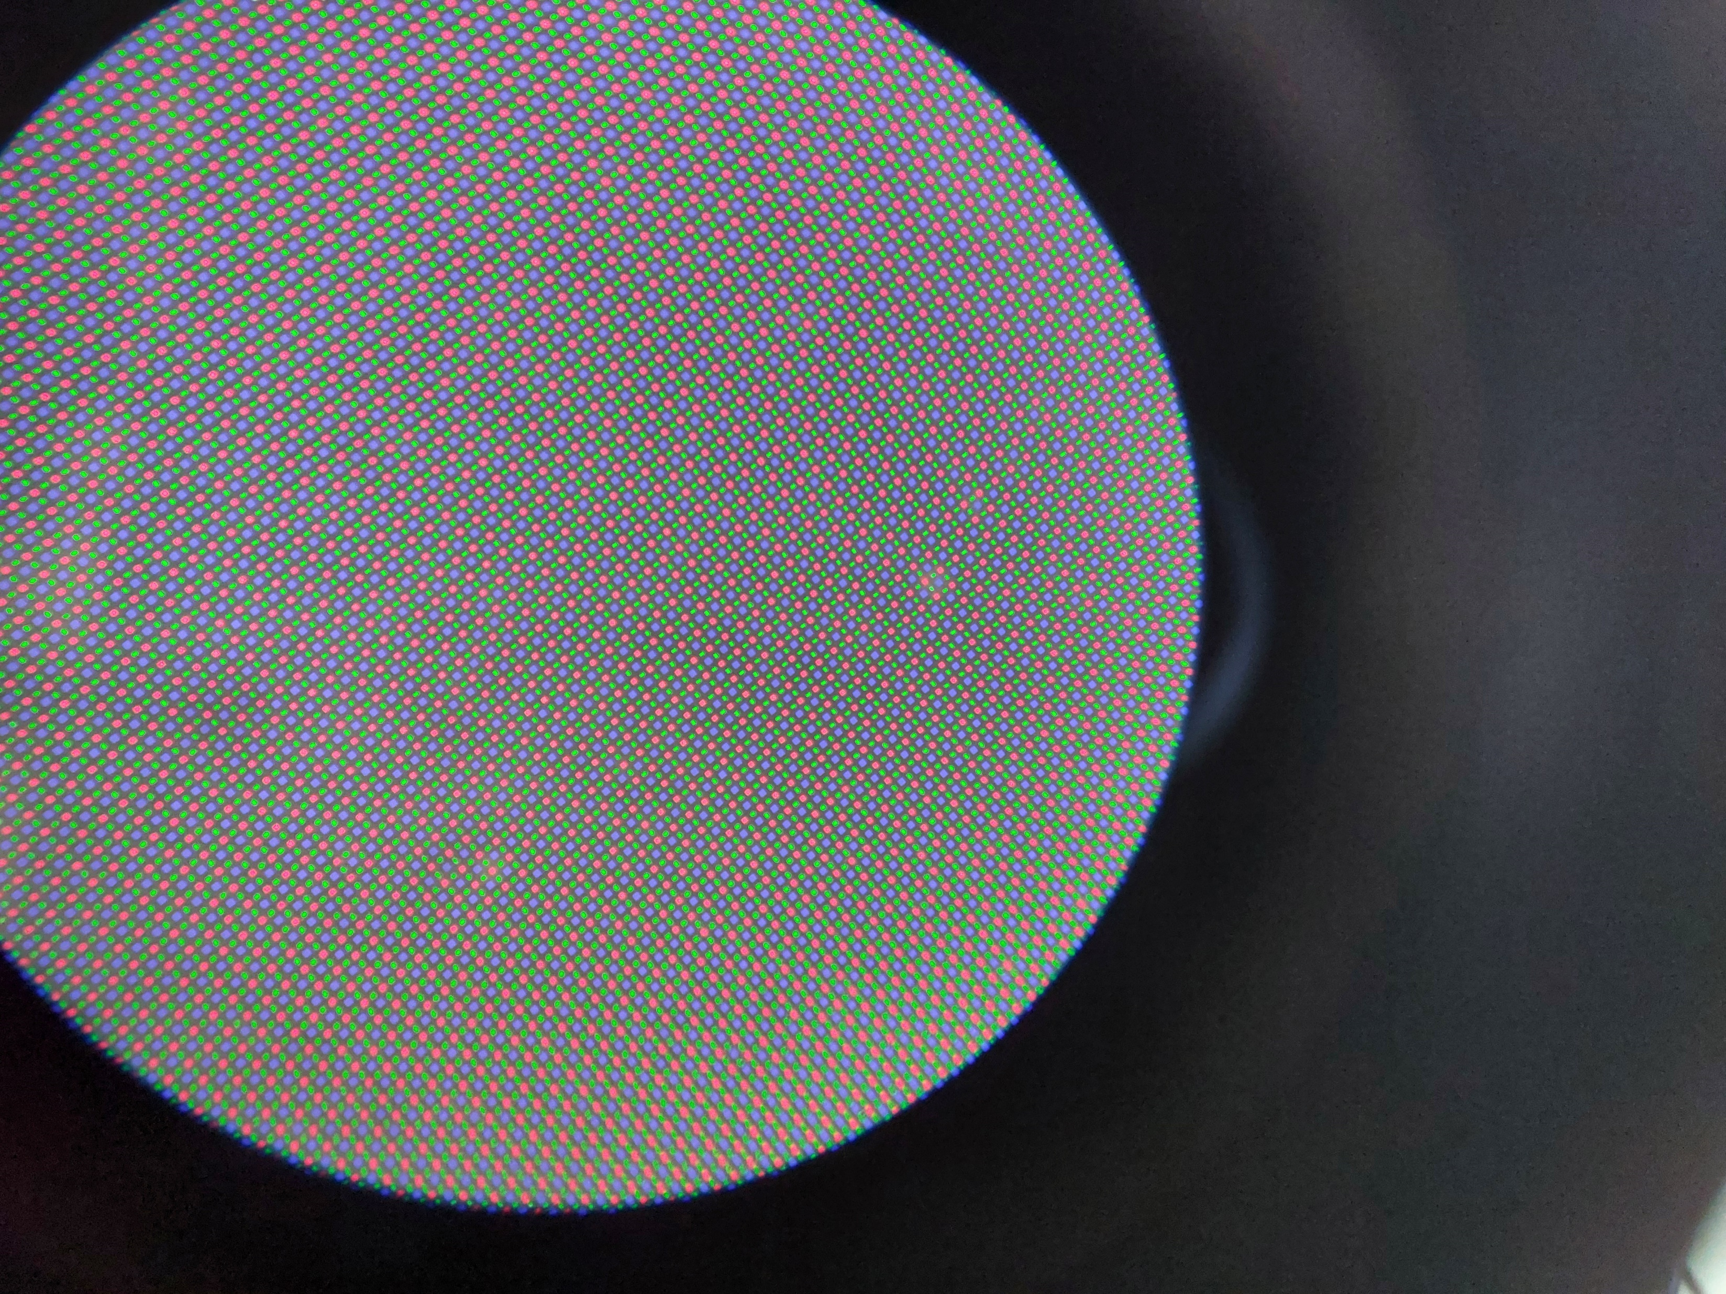
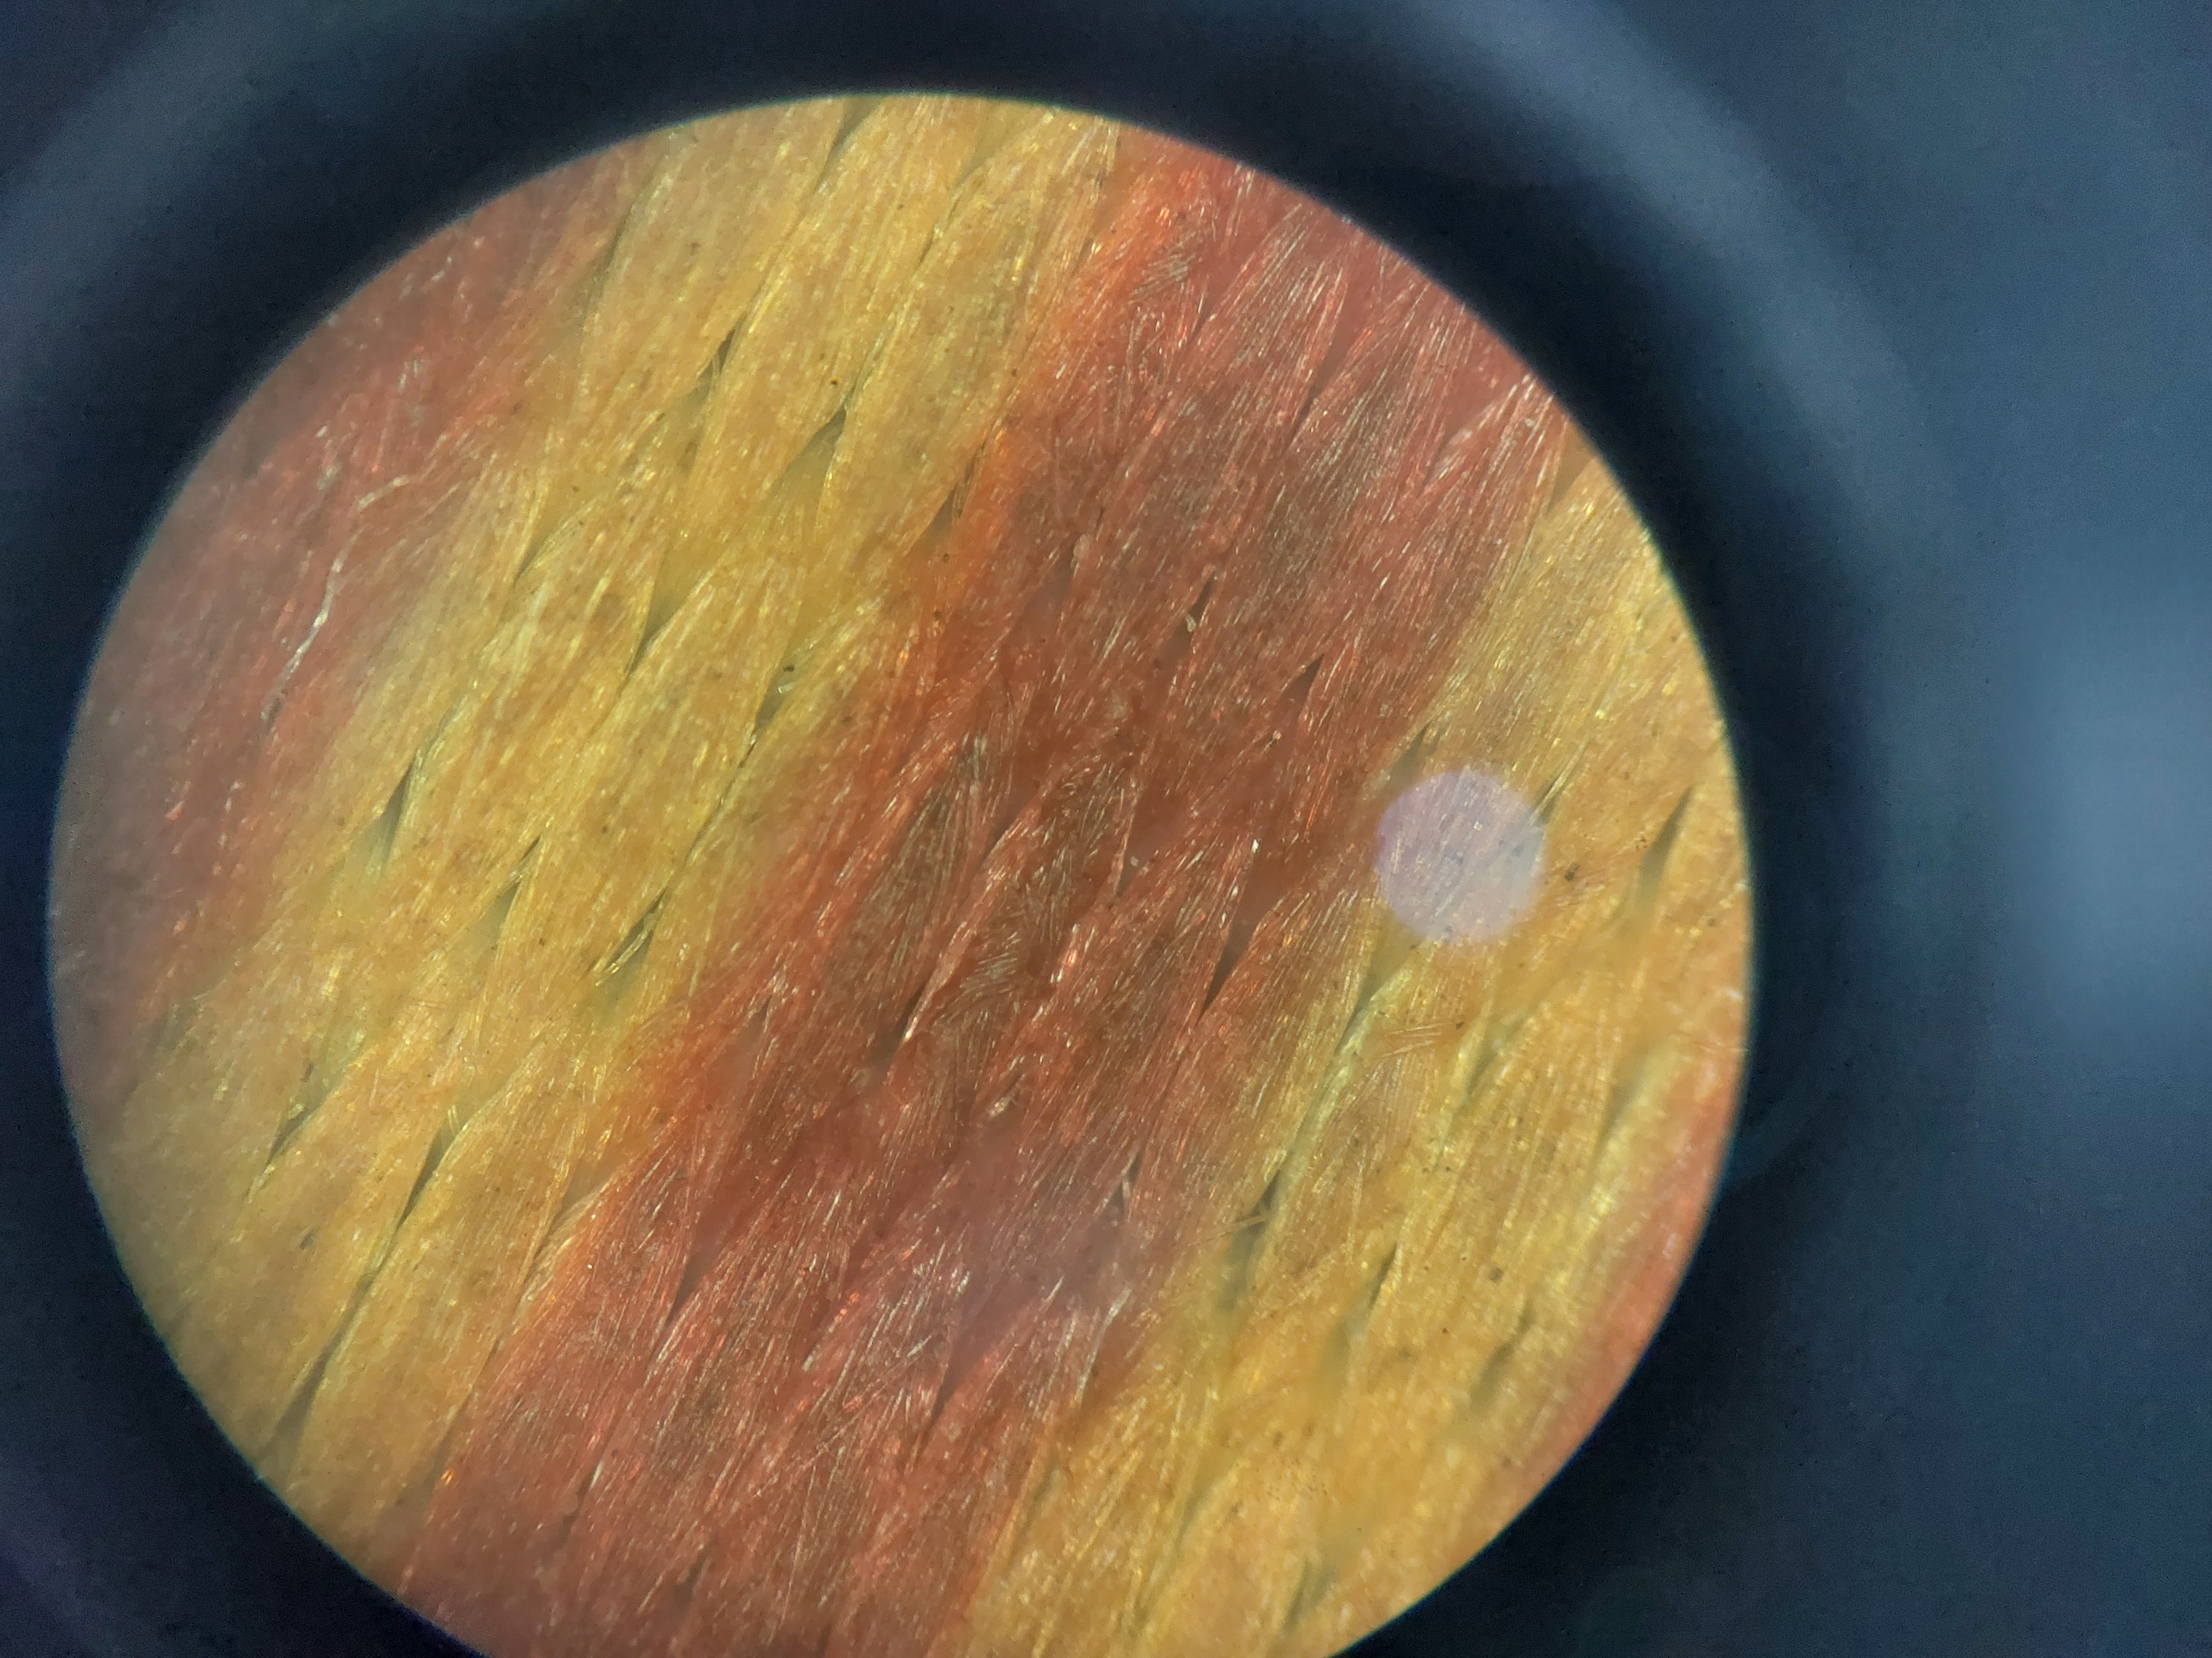
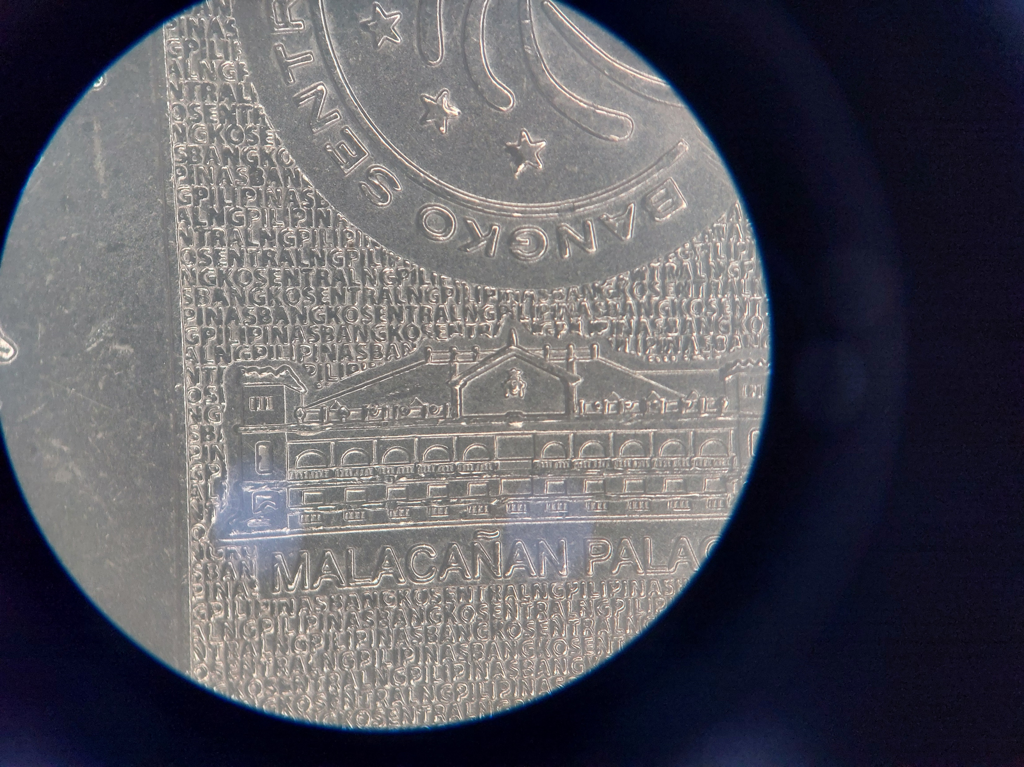
APP PHYSICS 167
FUNDAMENTALS OF MICROSCOPY
RESULTS AND DISCUSSION
(a) 20 Peso bill prints
(b) 5 Peso coin prints
(c) Bracelet threads
(e) Smartphone screen
(d) 1 peso coin Baybayin script
(e) Smartphone screen pixels
(f) 20 peso coin prints
Figure 2. Different images of the specimens observed under the stereomicroscope.
It can be discerned from Figure 2 that the stereomicroscope offers a much clear and magnified field view of various objects. While this can be applied to simple, common objects, the microscope used still has its resolution limitation where magnification is not enough to view much smaller details in clear perception.

Slide 5
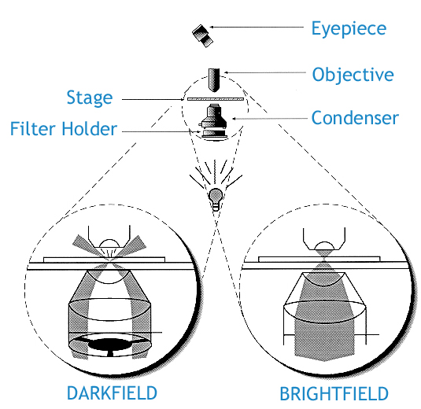
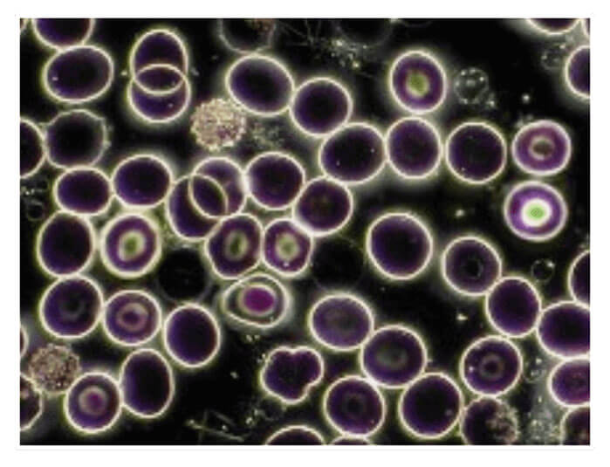
APP PHYSICS 167
FUNDAMENTALS OF MICROSCOPY
OTHER MICROSCOPY MODES
DARKFIELD MICROSCOPE
This microscopy technique takes advantage of transparent samples to observe them under a dark background. Samples are usually unstained compared to the usual techniques employed in other microscopes where staining gives the specimen a much more detail. Rather, the species are illuminated causing them to appear brightly in contrast to a dark background.
Mechanism. A specific condenser allows light to hit the specimen at a specific region. The light will then be scattered by the transparent specimen. Compared to the standard (brightfield) microscopes where the sample is illuminated with a filled cone of light, light is focused and scattered across at the apex (tip of the cone) for the darkfield technique.
Pros and cons. In the exchange of not staining the specimen, samples should be carefully prepared free of dust and other particles since light scattering is greatly affected by these. Since samples must be transparent enough to be illuminated, these must be spread evenly to avoid overlapping of layers and edges, which could eventually affect the study of such details.
Figures 3 and 4. Condenser differences and a specimen viewed under a darkfield microscope. Images sourced from this site and site.

Slide 6
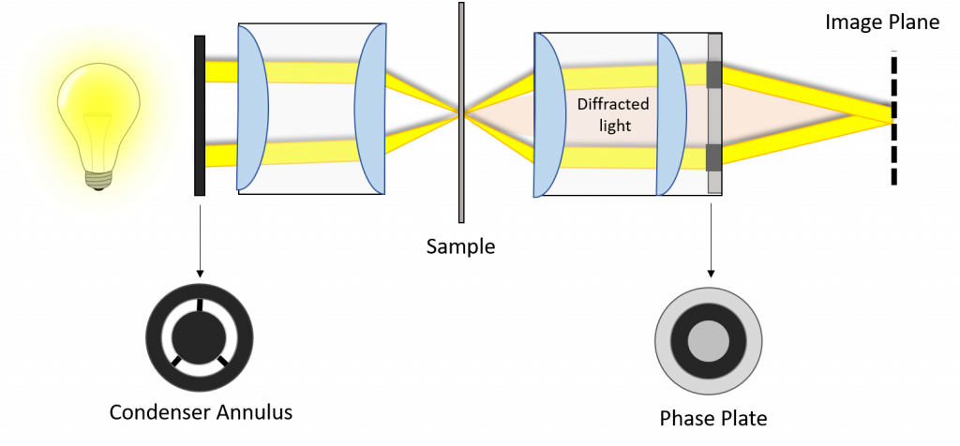
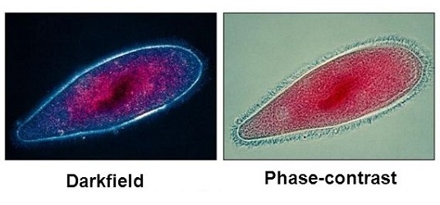
APP PHYSICS 167
FUNDAMENTALS OF MICROSCOPY
OTHER MICROSCOPY MODES
PHASE CONTRAST MICROSCOPE
Similar to darkfield microscopy, phase contrast microscopes also use light to enhance the field view of transparent specimens in contrast to a dark background. It also does not require any staining and is much ideal for much thinner samples. It is much more powerful than darkfield microscope as it is used to visualize transparent specimens in their natural state, i.e. living cells and cultures.
Mechanism. Compared to darkfield one that produces a light cone which reaches the objective upon scattering, the phase contrast microscope modifies the light trajectory such that a certain amount of light ray is modified by the sample and the rest is neglected using an objective phase plate and condenser annulus.
Pros and cons. Unlike the darkfield microscope, phase contrasting has the ability to yield a strong image contrast from specimens that do not absorb light at a high-resolution limit. However, strong contrast can also lead to contrast inversion brought by the stark difference between objects of high and low refractive indices, affecting the illumination of specimens.
Figure 5. Mechanism behind a phase contrast microscope. Image sourced from this site.
Figure 6. Differences in the specimen appearance under a darkfield and phase contrast microscopes. Image sourced from this site.

Slide 7
APP PHYSICS 167
FUNDAMENTALS OF MICROSCOPY
REFLECTION
I find the activity fun since I was able to try out the stereomicroscopes in viewing the small details of common objects. I also found out such details I did not know that exist in the object itself such as the prints in the Philippine peso banknotes and coins. The activity is straightforward to do and is easy to execute. I will give myself a grade of 100 / 100 for accomplishing the objectives of the activity!
REFERENCES | GITHUB
M. Soriano, Applied Physics 167 – Basic Microscopy.
3.3A: Dark-Field Microscopy - Biology LibreTexts
A Guide to Phase Contrast | Principles, Applications and Setup (scientifica.uk.com)
Phase-Contrast Microscopy (photometrics.com)

